Slide 1
DCC Training For Non-Public Schools
Level 0 Basics and Fall SIrS Reporting Tasks

Slide 2
NYS Reporting
NYS Reporting is the mandated collection of student and staff data for analysis at the local, regional, and State levels to improved student performance and to meet State and federal reporting and accountability requirements.
Data collection is through the NYS Student Information Repository System (SIRS) which provides a single source of standardized individual student records.
Level 0
Level 1
Level 2
MAARS
WNYRIC Regional Data Warehouse
State Data Warehouse (L2RPT)

Slide 3
Who’s Who in NYS Reporting
NYSED: The Information and Reporting Services (IRS) department collects and reports data on public districts, charter schools, and participating nonpublic schools in NYS.
Regional Level 1 Data Center: WNYRIC is our hosted Level 1 Data Center.
Monroe RIC: M.A.A.R.S. provides services related to State accountability, testing and data reporting. We house Level 0. We are your liaisons to WNYRIC and the IRS department.
Non-Public School: The District Data Coordinator oversees the collection of school data and acts as a liaison to M.A.A.R.S.

Slide 4
SIRS Reporting Levels
L2
L2RPT
(State)
System for collecting student and staff data through a series of databases
L1
WNYRIC
(Regional)
Level 0
(MAARS)
Level 0 Historical
(State)
SMS
State Assessments
Manual Entry
School Source System
MAARS

Slide 5
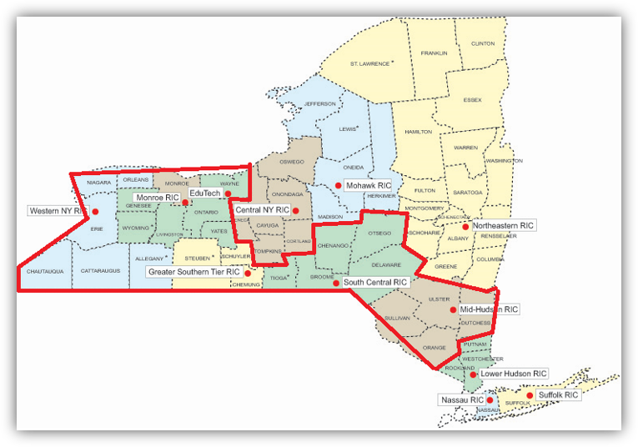
WNYRIC Data Warehouse - Level 1

Slide 6
Level 2 – State Data Warehouse
Level 2
L2RPT
ESSA
School Report Card
Federal Reporting
Federal and State Funding
PD System
(Pupils with Disabilities)
Systems populated by SIRS
How data from SIRS is used

Slide 7
What data is collected through SIRS?
Student Data
Demographic
Enrollment
Program Services
  ELL Eligible
  ELL Programs
  Type of Disability
Assessments

Slide 8
Student Data in SIRS​
Student Data​ | Level 0​ | SIRS Template​ | Data Source​ | SIRS Manual​
Who am I?​ | Demographics​ | Student Lite​ | SMS​ | Chapter 2:​ District of Residence Codes​ Graduates​ Career Pathways​ Chapter 5:​ District of Residence Codes​ Career Path Codes Credential Type Codes ​
Where am I?​ | Enrollments​ | School Entry/Exit​ | SMS​ | Chapter 2:​ Table of Reporting Responsibility​ Chapter 5:​ Enrollment (Beginning and Ending) Codes and Descriptions​
What Program Services do I participate in?​ | Program Fact​ | Programs Fact​ | SMS | Chapter 5:​ Program Service Codes and Descriptions​ ELL Eligible & ELL Programs
What assessments have I taken?​ | Assessment​ | Assessment Fact​ | SMS, College Board, IB​ (MAARS loads 3-8 ELA/Math, Gr. 5 & 8 Science, Regents, NYSITELL, NYSESLAT)​ | Chapter 5:​ Assessment Measure Standard Codes and Descriptions​

Slide 9
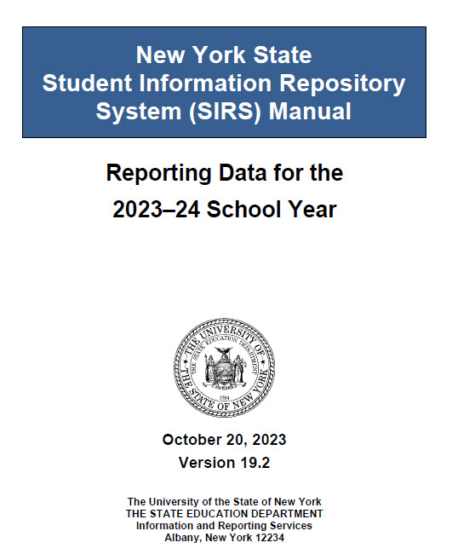

Data Reporting Resources
SIRS Manual: defines data elements and provides instruction on how data elements are reported https://www.p12.nysed.gov/irs/sirs/
SIRS Reporting Timeline: includes the deadlines for data verification and certification. https://www.nysed.gov/information-reporting-services
MAARS Team: help with questions about data reporting, Level 0, Level 1, and L2RPT.

Slide 10
SIRS Manual
The Big Book of State Reporting
  Be sure to download most current version
  Beware of printed pages
Most used sections
  Table of Reporting Responsibility
  Enrollment Codes and Descriptions
  Program Service Codes and Descriptions

Slide 11
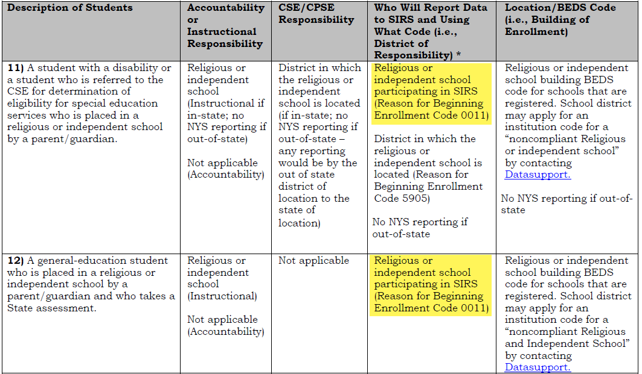
Table of Reporting Responsibility

Slide 12
Enrollment Codes and Descriptions
Common Enrollment Beginning Codes
Common Enrollment Ending Codes
  0011 – Enrollment in building or grade
  170 - Transferred to another NYS public school outside this district with documentation
    NOTE: Charter schools are public schools
  204 – Transferred to a NYS Religious and Independent School with documentation
  221 – Transferred to a school outside of NYS with documentation
  442 – Left the U.S.
  799 – Graduated (earned Regents or local diploma)
  782 – Entry into different grade in the same building
  459 - Deceased

Slide 13
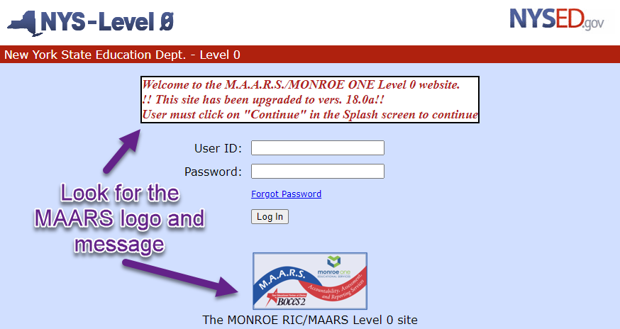
Level 0 - https://level0.monroe.edu

Slide 14
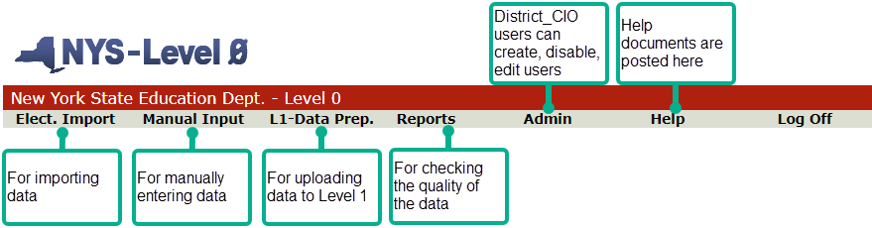
Level 0 Top Navigation Menu

Slide 15
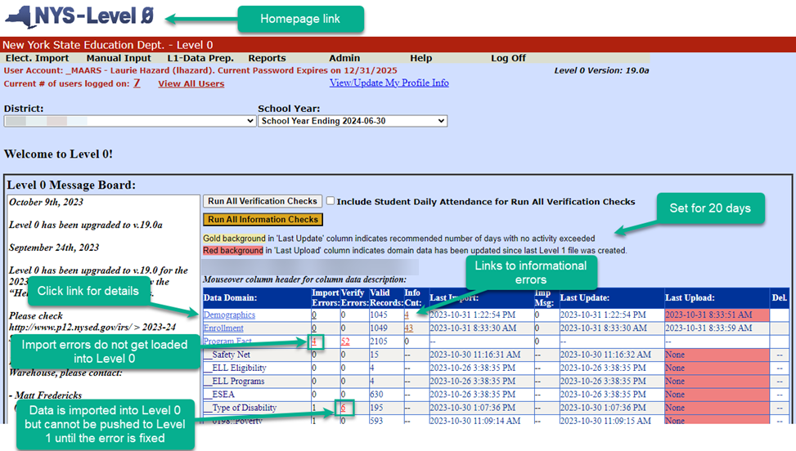
Level 0 Dashboard

Slide 16
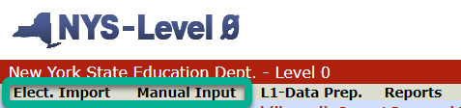
Entering Data into Level 0
2 ways to enter data
  Elect. Import
    .csv file or .txt file
    Must match escholar templates
    Export from SMS or other system
  Manual Input
    Hand enter data directly into Level 0
Data dependencies dictate in what order to enter data

Slide 17
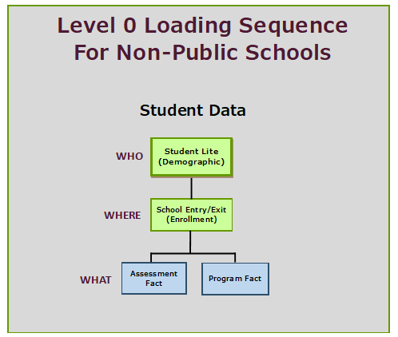

Slide 18
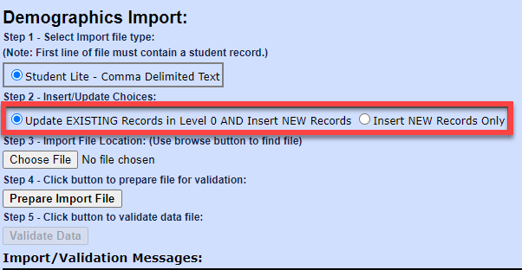
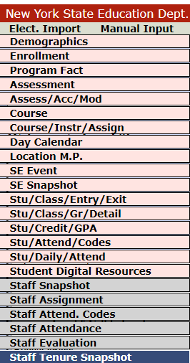
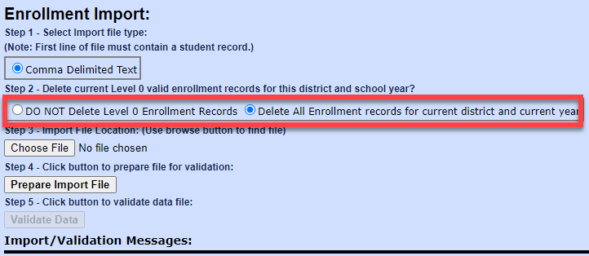
Electronic Import

Slide 19
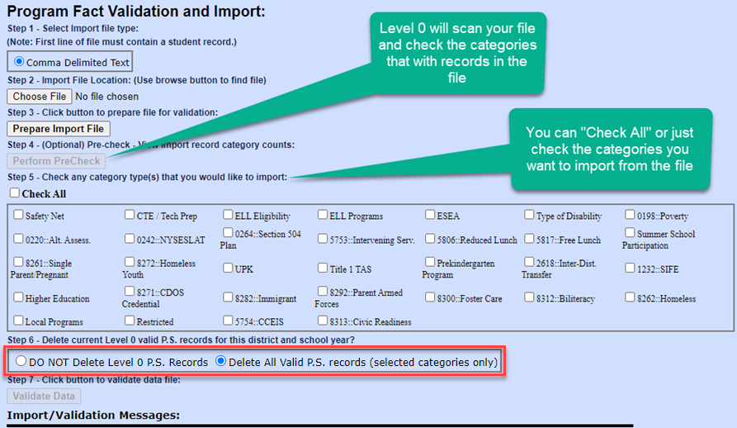
Importing Program Fact
Deleting ALL records in a Program Service Category
Import your Program Fact records
Perform the PreCheck
Select the category where all records need to be deleted
Contact Laurie Hazard or Matt Fredericks so they can tell Level 1 to delete the records for that category, too

Slide 20
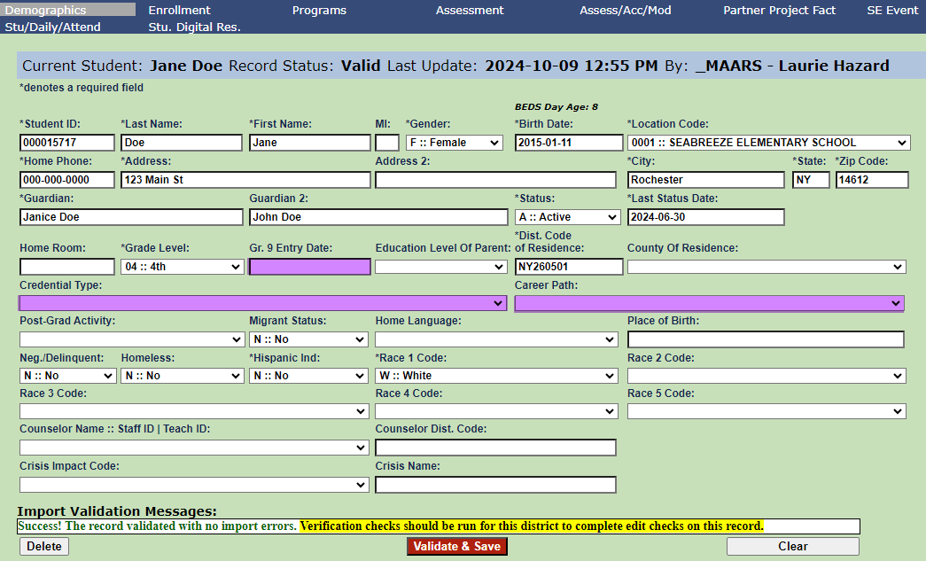
Manual Input - Demographics
Grade 9 Entry Date
  All high school students require this field be populated
  The day the student entered grade 9 for the first time
Graduates
  Credential Type: type of diploma
  Career Path:
    Pathway student used to meet requirements.
    HUM (passed both social studies Regents exams)
Last Status Date
  Last day of current school year (2025-06-30)
Dist. Code of Residence
  Student’s home district code

Slide 21
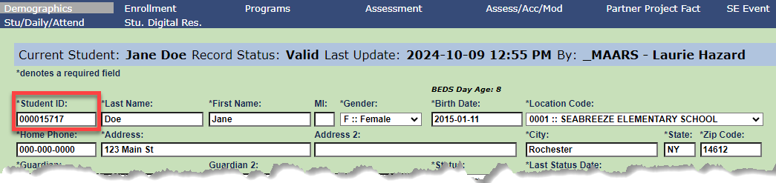
Student Local IDs
Student Local IDs
  Must be 9 digits
  Must be unique
  Must not be changed
Used to identify each student

Slide 22
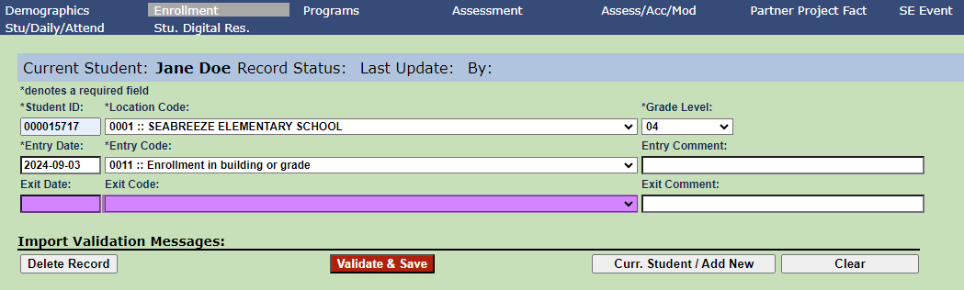
Manual Input - Enrollment
Exit Date
Exit Code
  Choose correct code from dropdown
  Be sure to exit any students who leave your school at the end of the school year

Slide 23
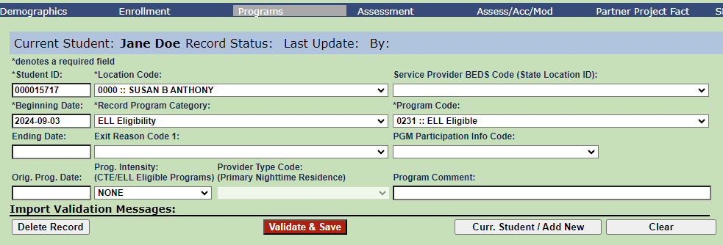
Manual Input Programs – ELL Eligible
ELL Program Intensity: Displays the level of service that the student receives.
  FULL – ELL eligible student receiving the required units of student;
  PARTIAL - ELL eligible student receiving less than the required units of student;
  NONE - ELL eligible student not currently receiving service.

Slide 24
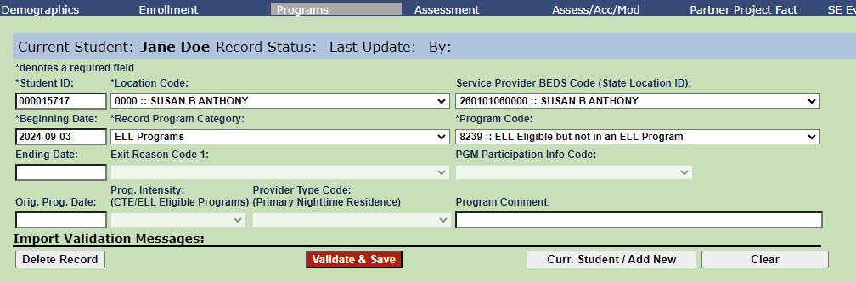
Manual Input Programs – ELL Program
Program Code
  8239 – ELL Eligible but not in an ELL Program
  5709 – English as a New Language
  5687 – One Way or Two Way Dual Language Program
  5676 – Transitional Bilingual Education (TBE) Program

Slide 25
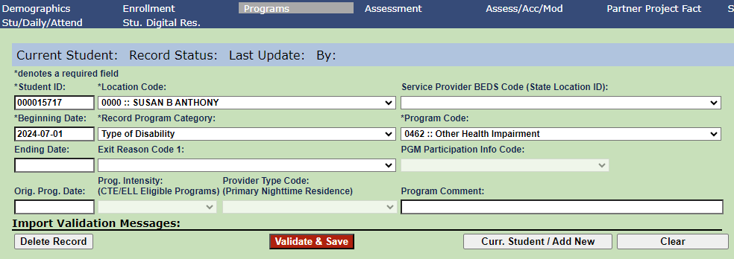
NEW – Type of Disability Program
The district in which your school is located has CSE responsibility for the student and can provide you with this information.

Slide 26
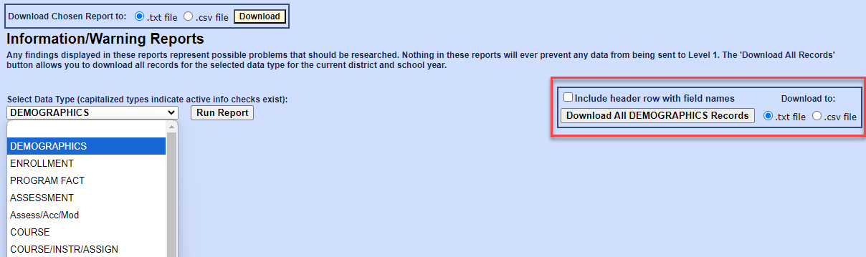
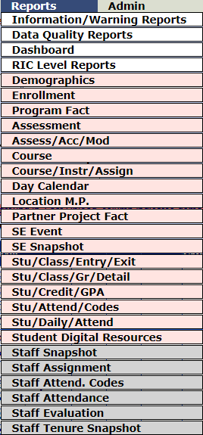
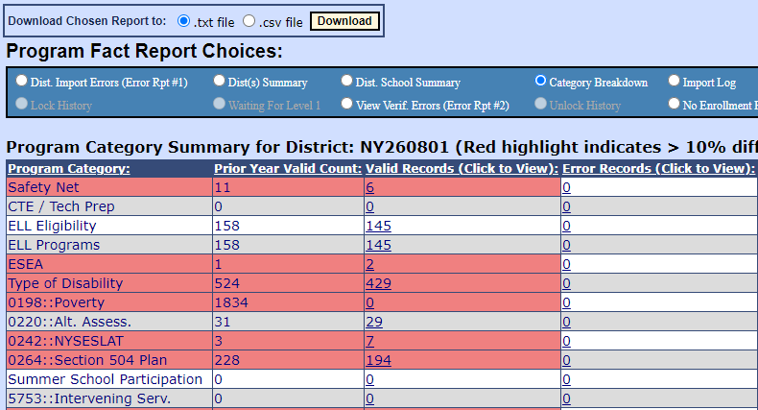
Reports

Slide 27
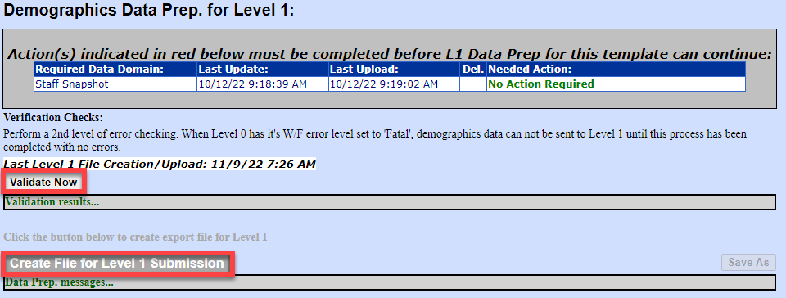
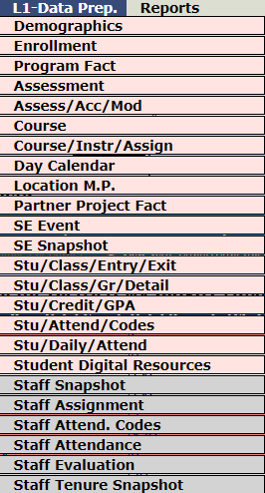
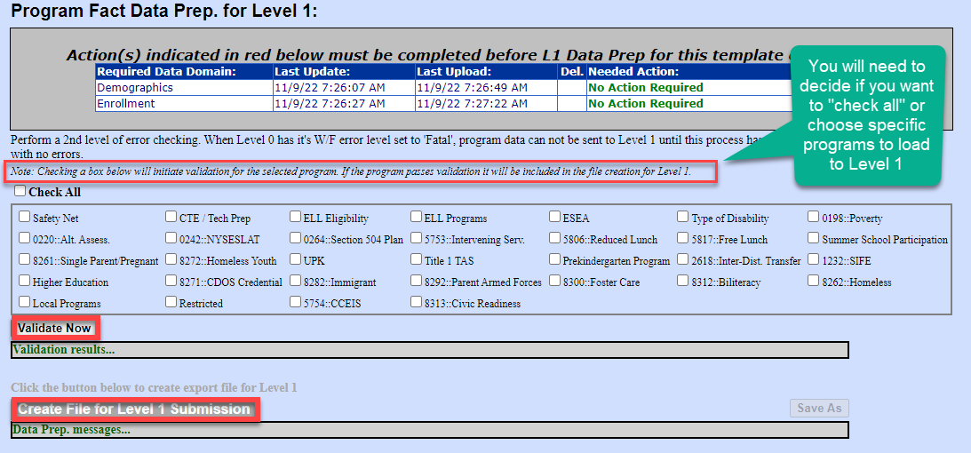
L1-Data Prep
1
2
3

Slide 28
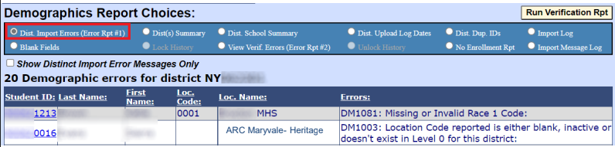
Level 0 Errors
Import Errors
  Relate to required missing or invalid data
  Data does not get loaded into Level 0

Slide 29
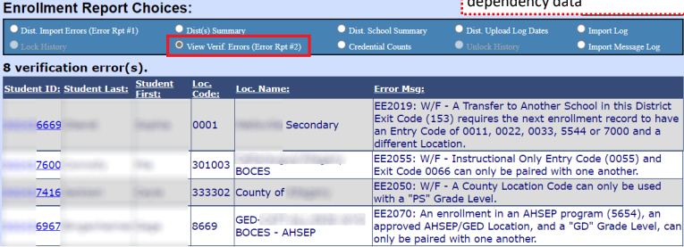
Level 0 Errors
Verification Errors
  Warning/Fatal (W/F) errors
  Result from a mismatch in dependency data

Slide 30
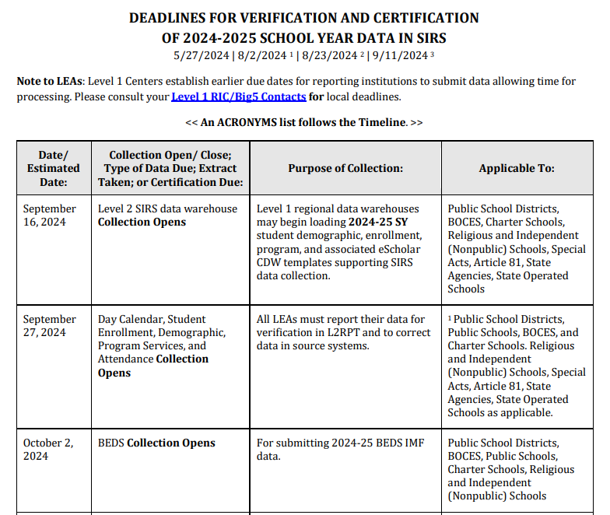
SIRS Timeline & Fall Tasks
The SIRS Timeline is posted under Quick Links on the IRS website:
https://www.nysed.gov/information-reporting-services
MAARS dues dates are always the day before on Thursday by noon
Work backwards from due dates
  If data is due Thursday, 1/25…
  Then plan to have your data loaded 2 weeks before on Thursday, 1/11
  Plan to verified L2RPT reports on Monday 1/15 so that you can make corrections by Thursday, 1/18
  This will leave you one last week for final corrections

Slide 31
Fall/Winter Data Reporting Tasks
Opening of Data Warehouse (Sept/Oct)
  Demographics (Student Lite)
  Enrollments (School Entry/Exit)
  Programs
August Grads
  Demographic (Student Lite)
  Enrollments (School Entry/Exit)
  Data due Thursday, Oct 17
BEDS IMF Collection
  This form is completed on the IDEx in the NYSED Business Application Portal
  https://www.p12.nysed.gov/irs/beds/IMF/home.html
  Form due November 15
NYSESLAT Pre-ID Data Due
  Data used for labels for NYSESLAT test
  Demographic and Enrollment
  ELL Eligible – 0231 Program
  Data due February

Slide 32
Monthly Data Updates
Check and update data monthly
  Demographics (Student Lite)
  Enrollments (School Entry/Exit)
  Programs
Pay attention to MAARS Weekly Digest
  3-8 CBT & PBT data deadlines
  Regents data deadlines
Level 0 Training Video: https://www.monroe2boces.org/protected/SecuredAccess.aspx?redirect=RecordedWebinarsTrainings.aspx

Slide 33
Questions?

